Slide 1
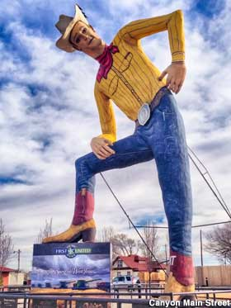
Art Around Amarillo
ARTS 1301 Art Appreciation

Slide 2
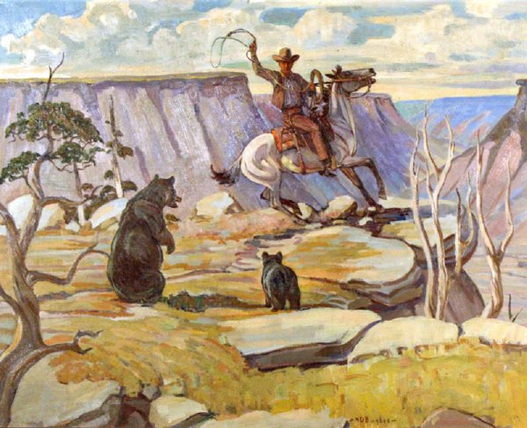
Bears at the Palo Duro, 1931 mural by Harold Bugbee, Panhandle-Plains Historical Museum, Canyon, Texas

Slide 3
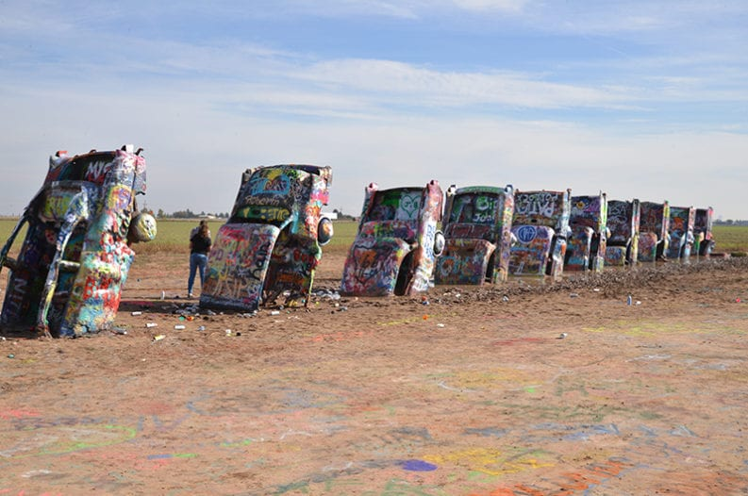
Cadillac Ranch, Installation, by Art Farm, Commissioned by Stanley Marsh 3, I-40 west of Amarillo

Slide 4
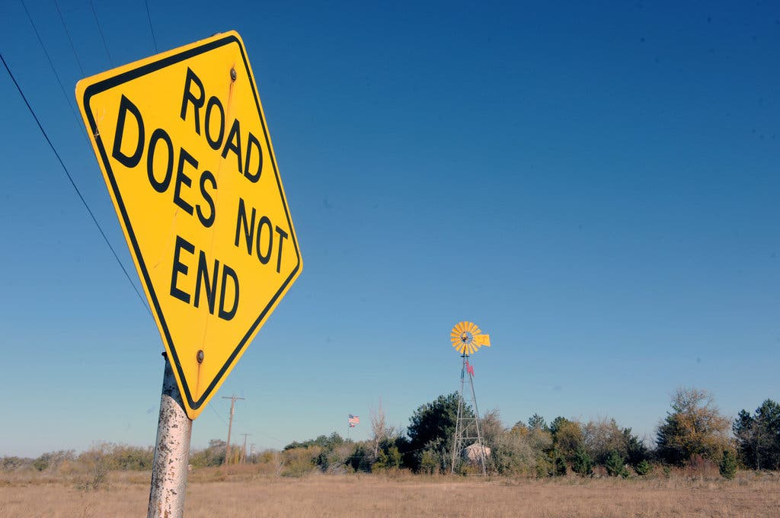
Traffic signs, by various artists, collectively known as the Dynamite Museum, commissioned by Stanley Marsh 3, all around Amarillo

Slide 5
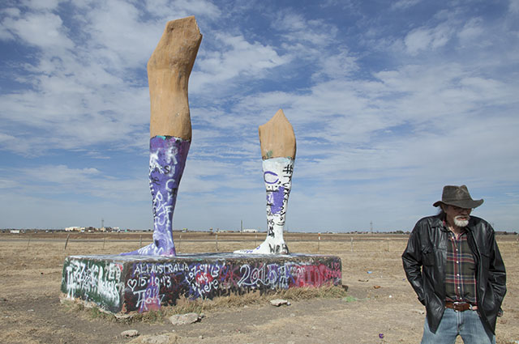
Ozymandias, steel and concrete sculpture by Lightnin’ McDuff (shown right), 1996, commissioned by Stanley Marsh 3, between Randall High and I-27 south of Amarillo, Texas

Slide 6
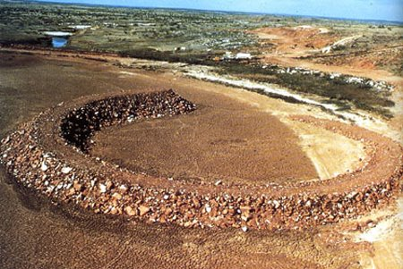
Amarillo Ramp, earthworks by Robert Smithson commissioned by Stanley Marsh 3, on Marsh’s land west of Amarillo

Slide 7
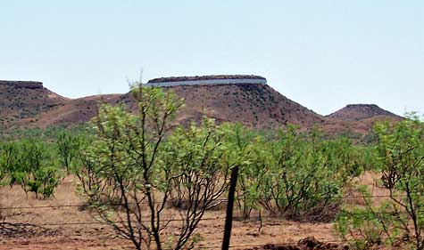
Floating Mesa, earthworks by Andrew Leicester, commissioned by Stanley Marsh 3, on Marsh’s land west of Amarillo

Slide 8
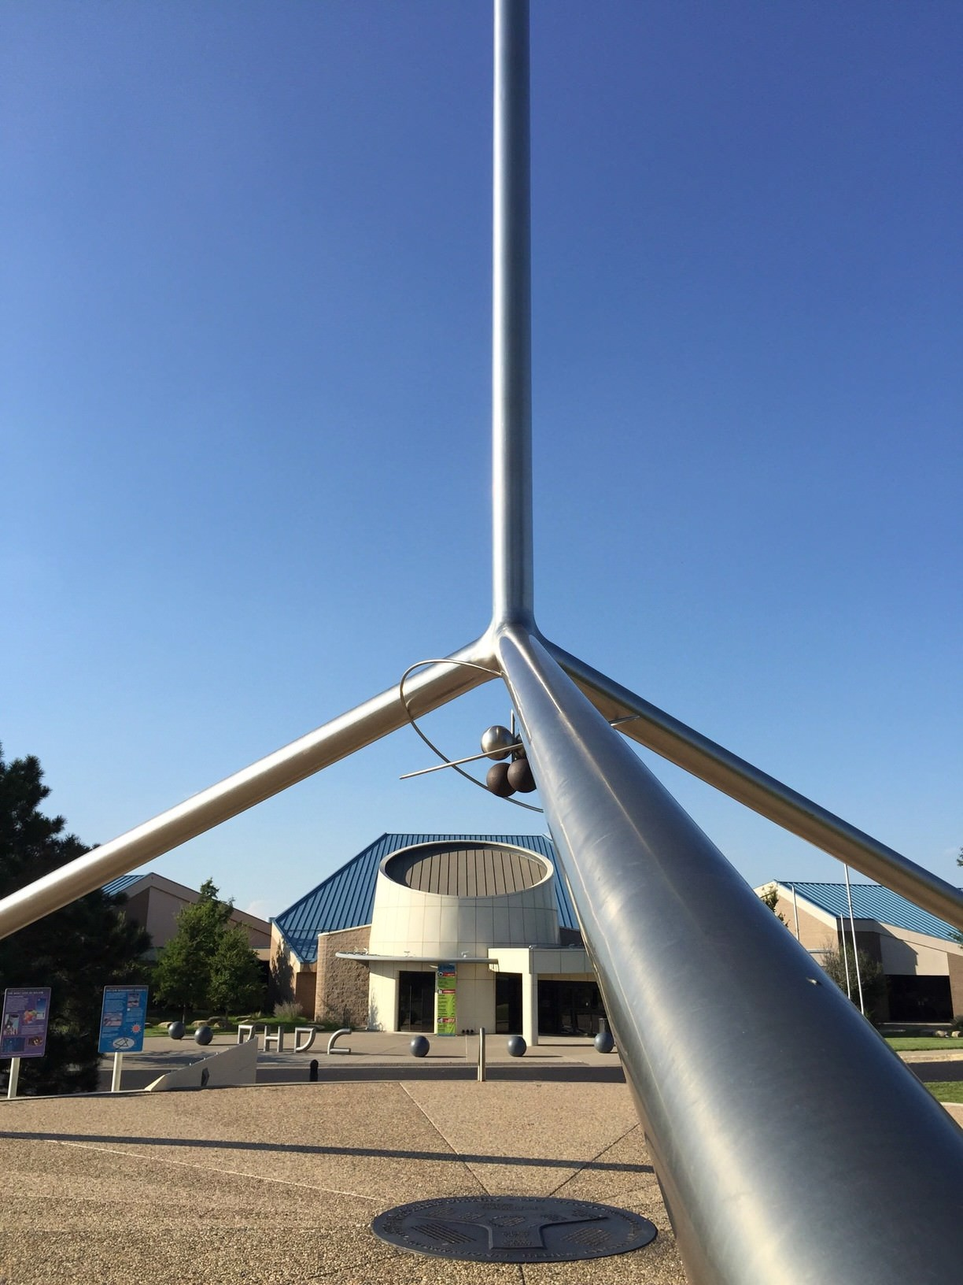
Helium Monument, by Peter Muller, Don Harrington Discover Center, Medipark, Amarillo

Slide 9
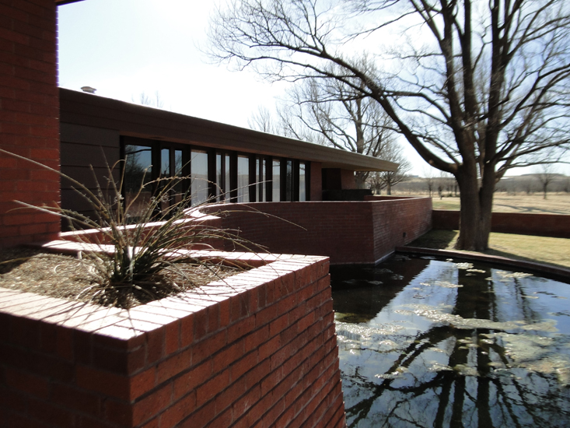
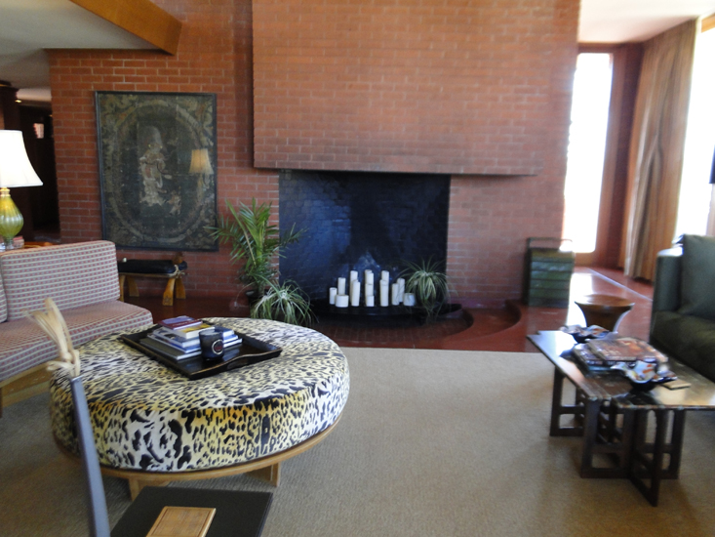
Frank Lloyd Wright house west of Amarillo.
“Mid-century Architecture” 1957 The Sterling Kinney House near Bishop Hills, west of Amarillo

Slide 10
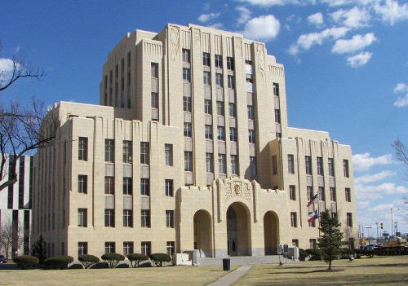
The architecture of the Potter County Courthouse, 1932, is one of the best examples of the “Pueblo Deco” design during the 1920s and 30s in the Southwest USA.

Slide 11
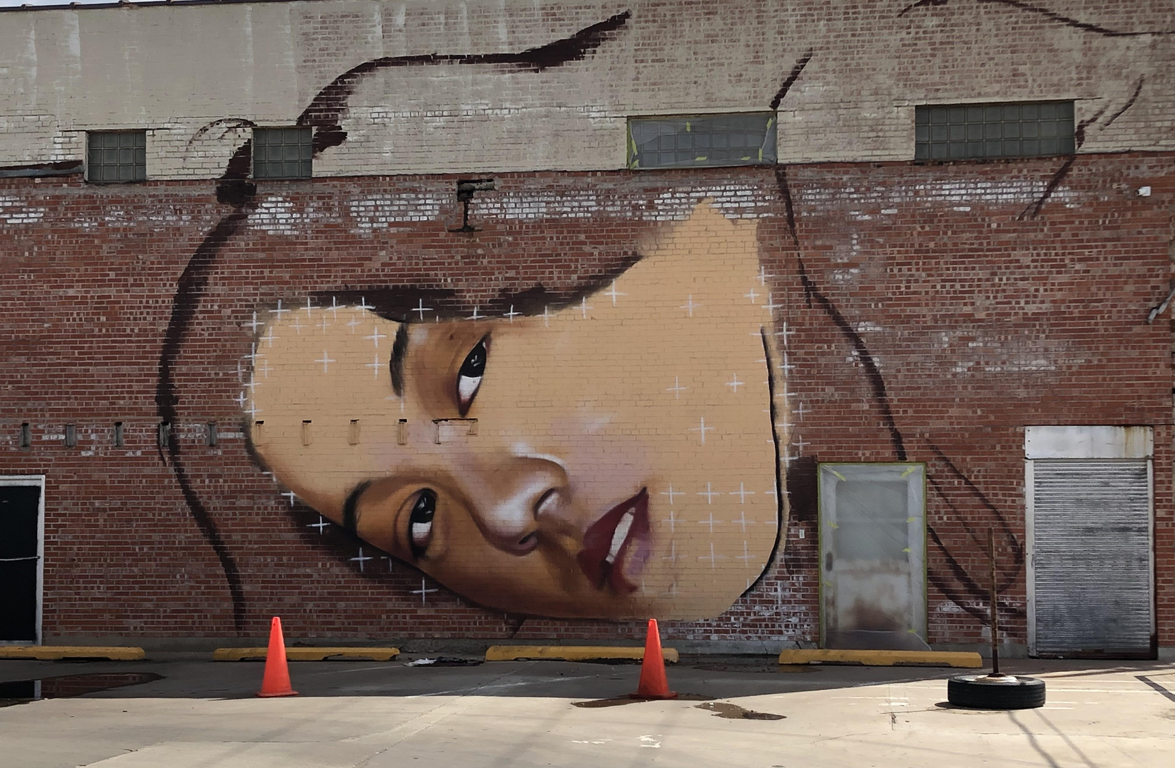
Mural, by Malcolm Byers, downtown Amarillo between Harrison and 6th streets

Slide 12
S. E. 10th St. Barrio Neighborhood Mural Project,

Slide 13
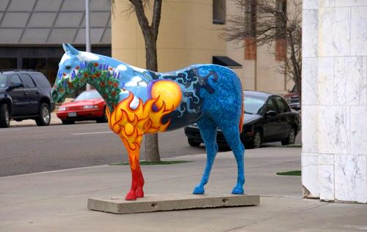
America’s Quarterhorse statues

Slide 14
Tex Randall, statue by William Wheeler, Canyon, Texas

Slide 15
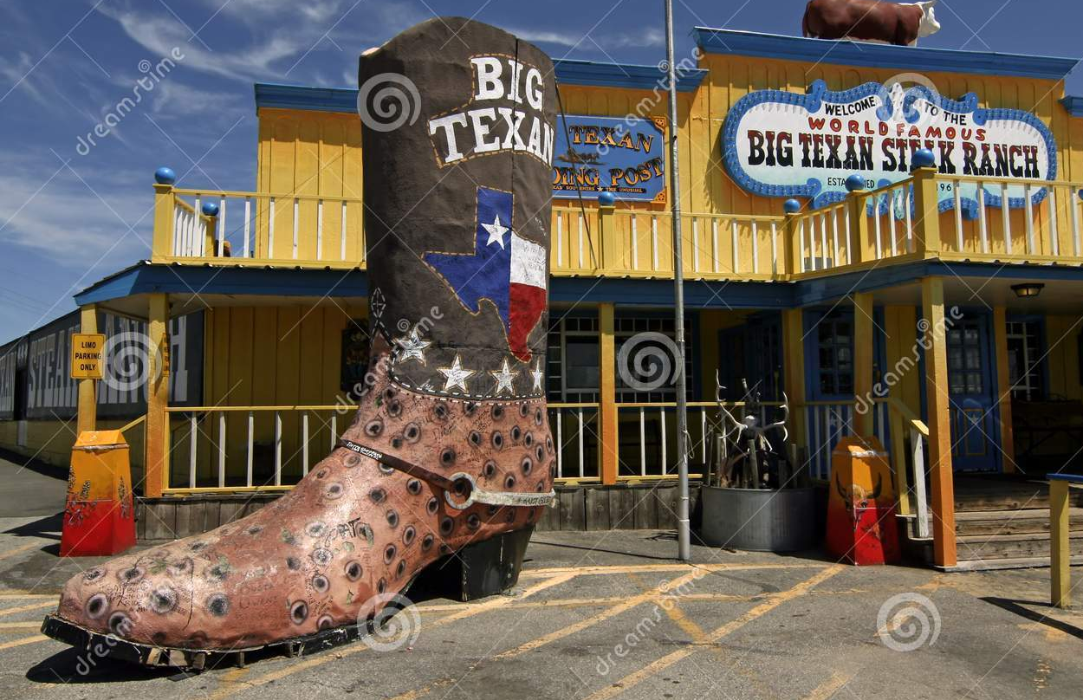
Big Texan Boot, Big Texan Steak Ranch I-40 east side of Amarillo

Slide 16
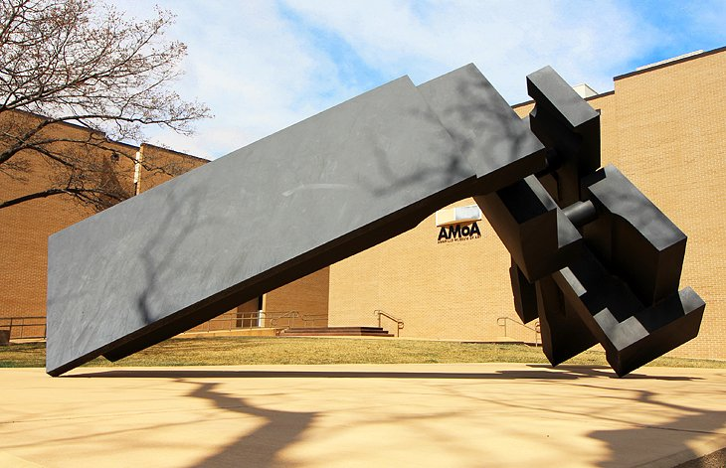
Night Hawk, welded steel by David Deming, Amarillo Museum of Art

Slide 17
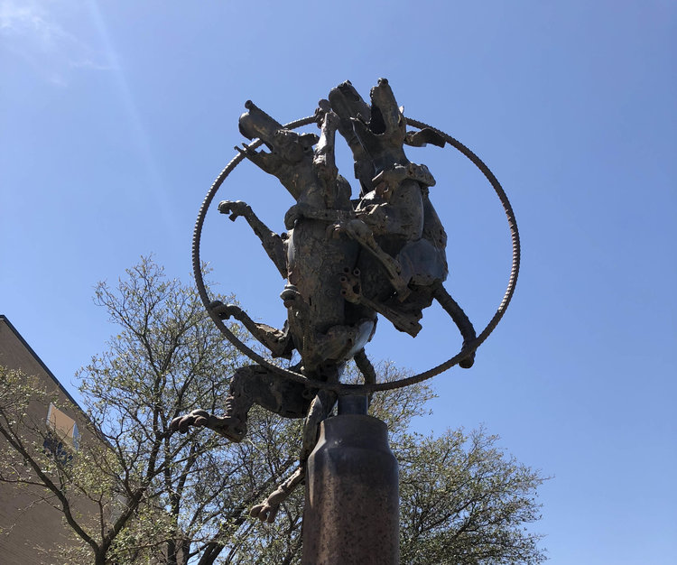
It’s So Hard to Stay on Top, welded steel by David Deming, Amarillo Museum of Art

Slide 18
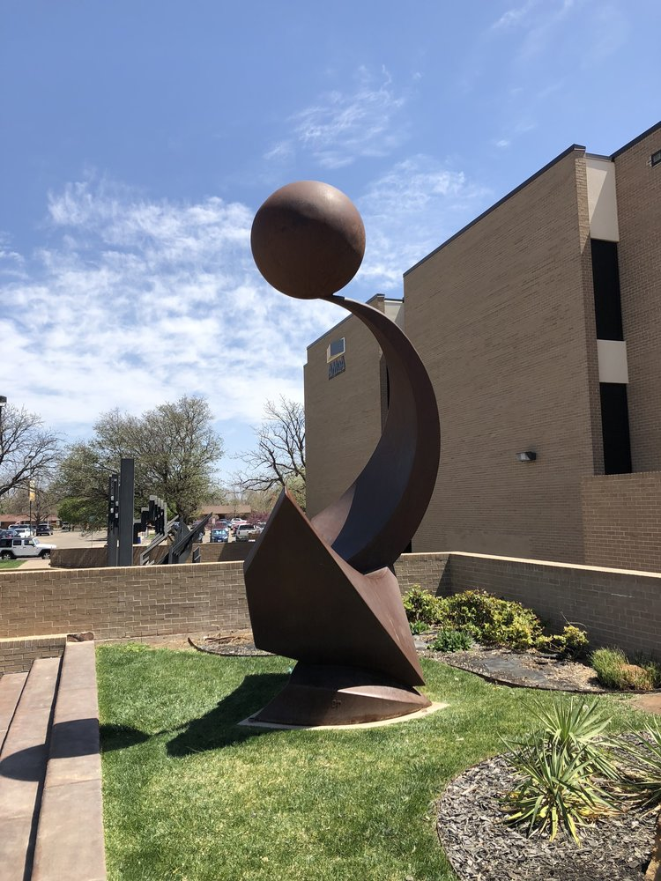
Talon Sweep, welded steel by John Brough Miller, Amarillo Museum of Art

Slide 19
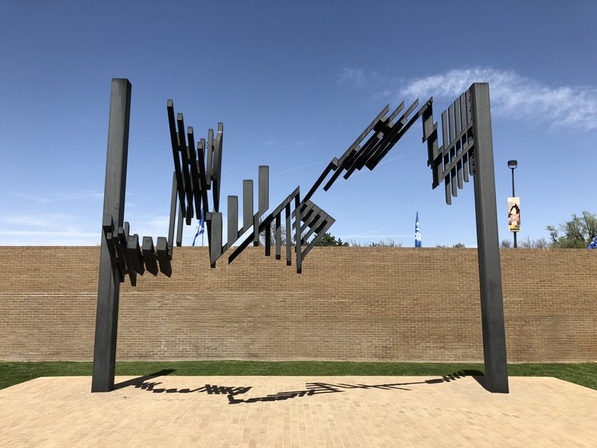
Archway, welded steel by Ben Woitena, Amarillo Museum of Art

Slide 20
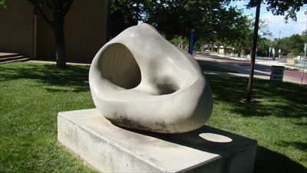
Continuous Line, limestone by David Rogers, Amarillo Museum of Art

Slide 21
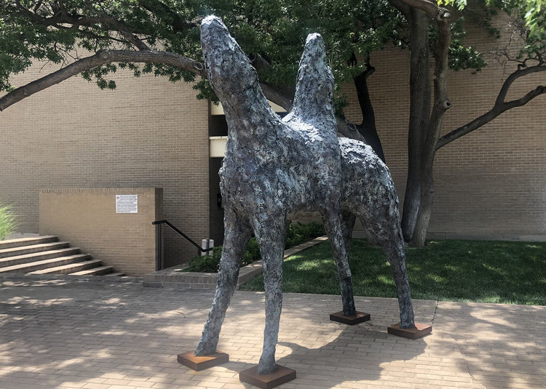
Mussellshell Rider, limestone by Theodore Waddell, Amarillo Museum of Art

